Slide 1

Bank Marketing
virtual internship
Dec-15-2022

Slide 2

Agenda
Background
EDA
Modelling Recommendations

Slide 3
Background
ABC Bank wants to sell its term deposit product to customers and before launching the product they want to develop a model which can help them in understanding whether a particular customer will buy their product or not (based on customer's past interaction with the bank or other Financial Institutions).
Goals : ABC Bank wants to use ML models to shortlist customers whose chances of buying the product is more so that their marketing channel (tele marketing, SMS/email marketing etc) can focus only on those customers.

Slide 4
Roadmap
NA/NULL
Duplicate
Data
EDA
Feature Engineering
Modelling
Data balance
Outlier removal

Slide 5
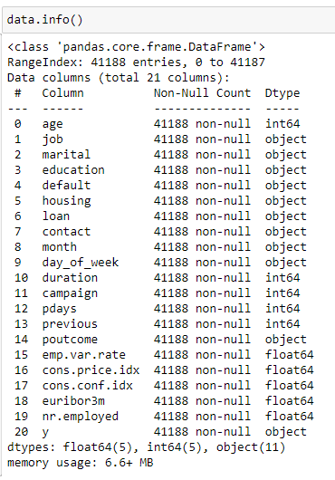
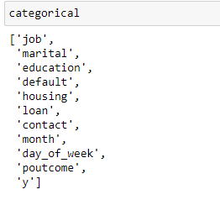
Data info
21 features in total
11 categorical features

Slide 6
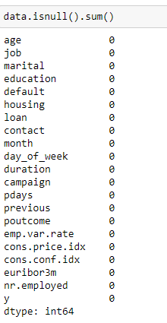
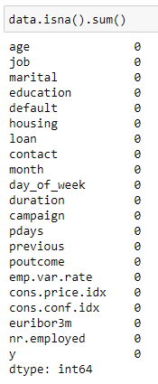
Missing values
0 Null or NA values

Slide 7
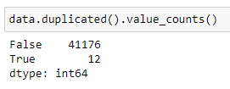
Duplicate rows
12 duplicate rows

Slide 8
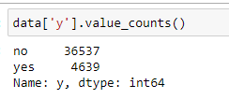
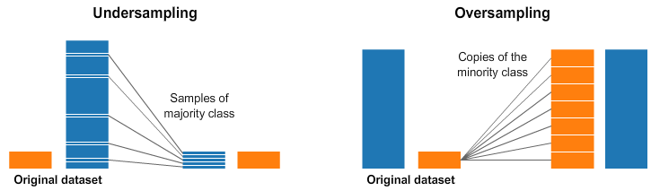
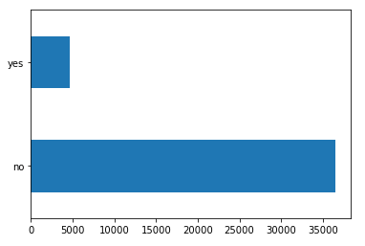
Data balance

Slide 9
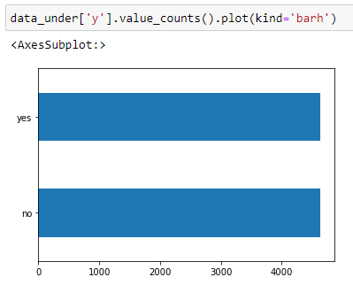
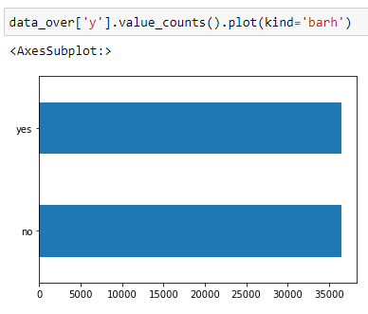
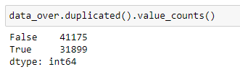




Data balance – undersampling and oversampling
0 duplicate row for undersampling
Many duplicate rows for oversampling

Slide 10
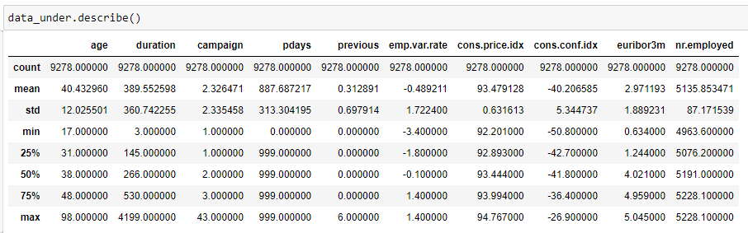
Outlier removal

Slide 11
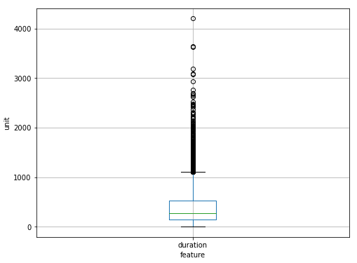
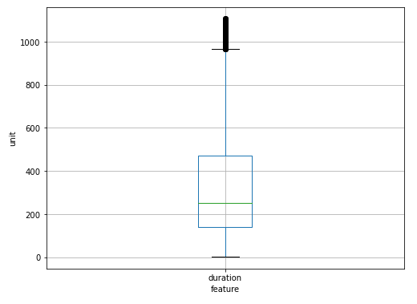
Outlier removal

Slide 12
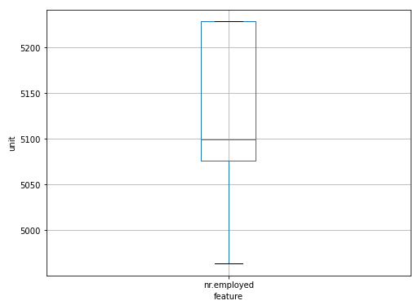
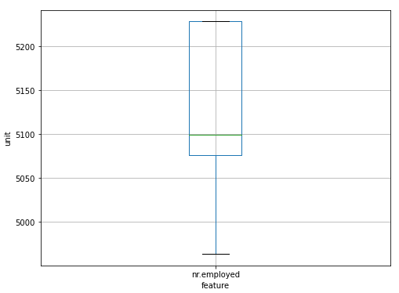
Outlier removal

Slide 13
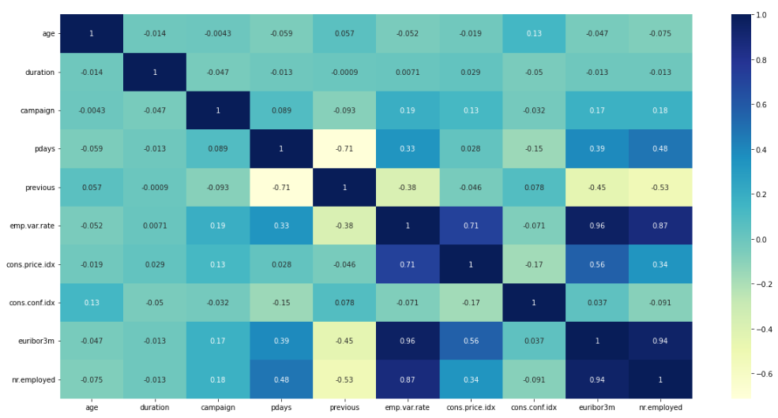
Feature Engineering

Slide 14
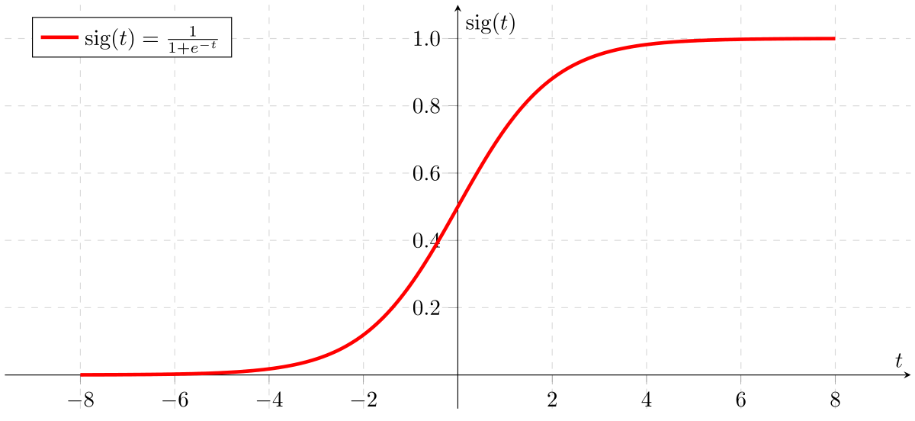
Modelling Recommendations
Logistic Regression

Slide 15
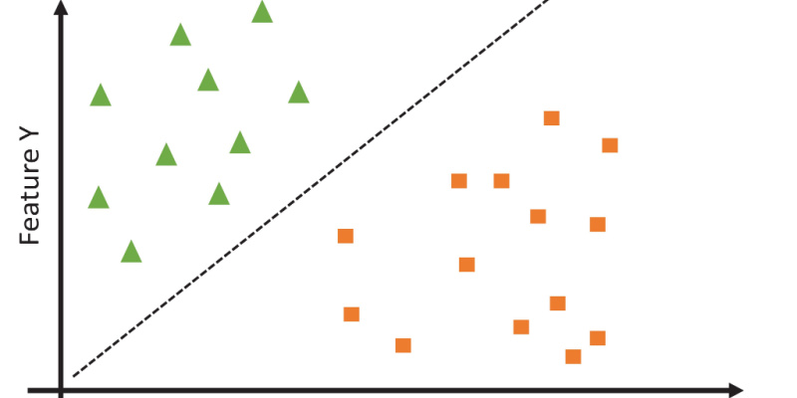
Modelling Recommendations
SVM

Slide 16
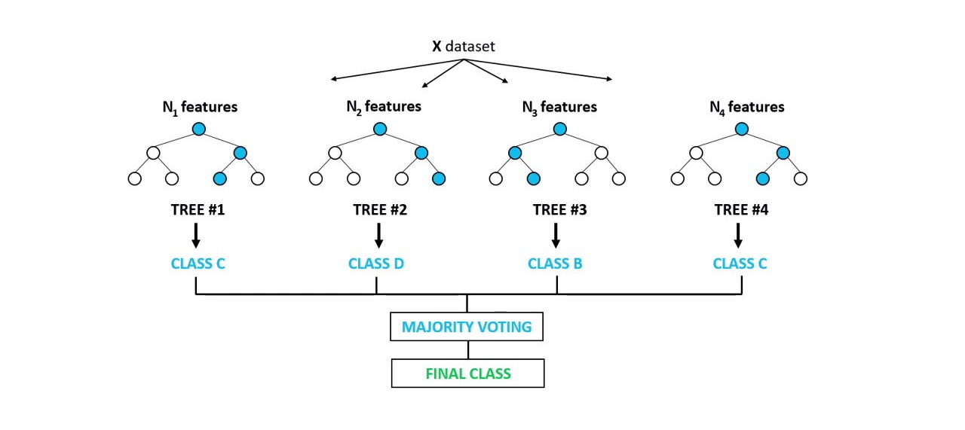
Modelling Recommendations
Random Forest

Slide 17
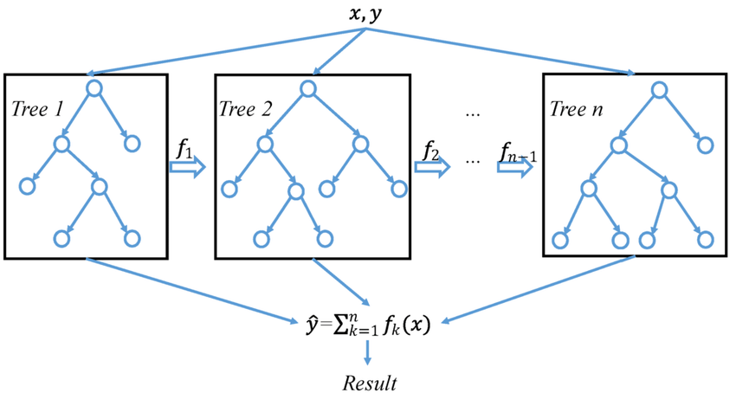
Modelling Recommendations
Xgboost

Slide 18
Thank You

